Slide 1
Association between depression and poverty
Daniel lagos
Ana 500
October 2, 2022
https://github.com/danlagos/ANA500

Slide 2
Problem statement
Background: Using California Health Interview Survey (CHIS) 2020 to search for an quantify the association between depression and poverty levels after controlling for general health, and current smoking habits in adults in the state of California.
Objective
How does poverty levels affect depression in adults?
What are the effects of general health and smoking habits, and do they interact with poverty levels?
Is there an ordinal component to the data? Meaning, it is possible that poverty has an ordinal component, and may affect the model
Type of analysis will be determined in a later phase of this project, meaning will a multivariate regression or machine learning algorithm be used. This author is not versed with machine learning algorithms, yet.

Slide 3
Hypothesis formulation
H₀: There is no statistically significant association between depression and poverty levels after controlling for general health, and current smoking habits
H_{A}: There is a statistically significant association between depression and poverty levels after controlling for general health, and current smoking habits

Slide 4
Top-down program design
Overall Task: Develop Python program that takes CHIS 2020 as input and outputs predicted effect on depression levels.
Steps to take
Acquire: identify data set, retrieve data, query data. CHIS has already been selected. Currently in SAS XPT format.
Prepare: analyze codebook, explore and process data using python and discovery from codebook.
Analyze data: select analytical technique, build model
Report: communicate results – not inclusive to code development
Act: apply results, connect results with problem statement – not inclusive to code development

Slide 5
Hierarchy chart
DEPRESSION = CHIS2020DATASET(POVERTY, GENERAL HEALTH, SMOKING)
Main Program( output depression, input CHIS dataset)

Slide 6
Flow chart
Start
Load data
Preliminary analysis: ID data set features, statistically describe data
Visualize: Plot each feature against output variable (depression) to understand data
Clean Data: handle missing values

Slide 7
pseudocode
# Start
# STEP 1 Acquire data: from CHIS website
# Import libraries: pandas, numpy, seaborn, matplotlib
# Read dataset: import data. Must read in SAS XPT file into Python
#STEP 2: Prepare – conduct analysis of codebook – identify appropriate variables, and determine structure
# read data: data.head(), data.info()
# Format data: create new data set with appropriate variables– SMOKING, AB1, POVLL, AJ32
# Remove inappropriate values – AJ32(Variable for depression) contains value of -2 (means proxy skipped). Not applicable, remove.
# Visualization: make histograms, scatter plots and bar charts, use as appropriate.
End program

Slide 8
Acquire
Data set was acquired via CHIS website (https://healthpolicy.ucla.edu/chis/data/pages/getchisdata.aspx). This is a well respected and well cited survey repository that conducts surveys to delve into California's public health issues.
CHIS website proved extensive codebook to assist in analysis and will be relied upon for the data preparation of this project.

Slide 9
prepare
Codebook identifies AJ32, variable for depression with value of -2, meaning proxy missing.
All other variables are categorical numeric

Slide 10
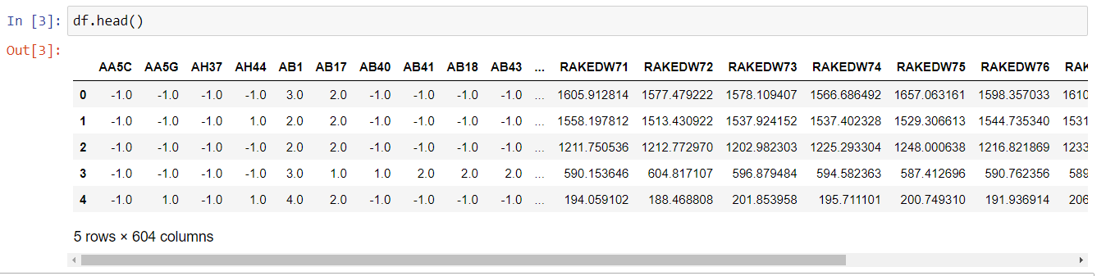
prepare

Slide 11
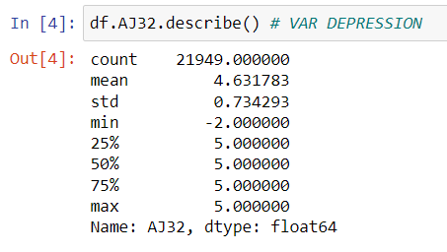
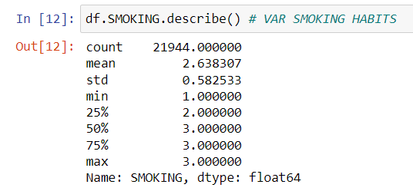
prepare
Confirming that no other variables contain unusable values. AJ32 with values of -2

Slide 12
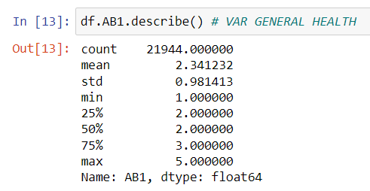
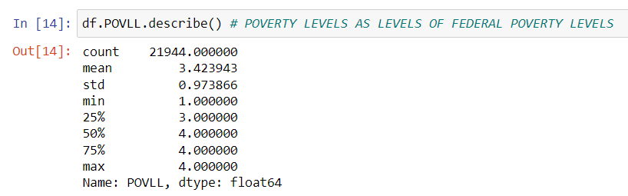
PREPARE
Confirming that no other variables contain unusable values

Slide 13
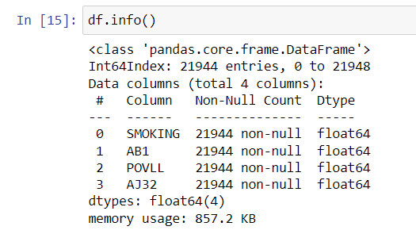
PREPARE
Confirming lack of missing values

Slide 14
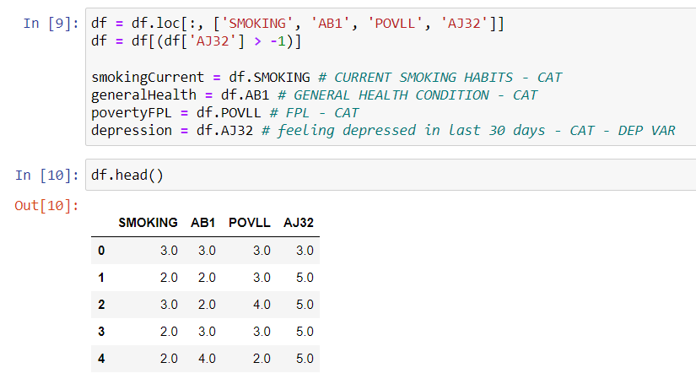
prepare
Clean data

Slide 15
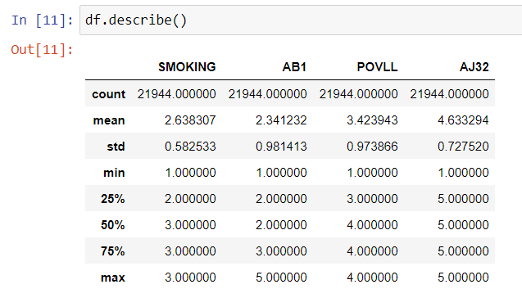
prepare
Confirming data set is clean: all values over 0, n= 21,944, devoid of variables not in use.

Slide 16
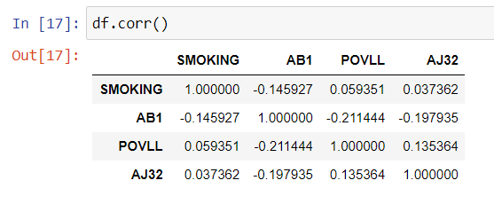
Prepare
Correlation Matrix: note AJ32 var for Depression. In terms of absolute values, generally weak correlations with independent variables.

Slide 17
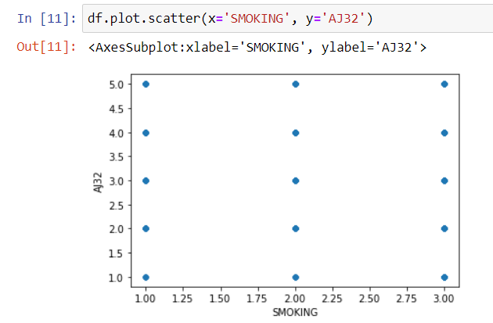
Prepare - visualization
After conducting data.hist(), data.scatter() and data.plot.box() it has been determined that scatter plots are inappropriate: example of output of scatter plot below. They are not insightful.

Slide 18

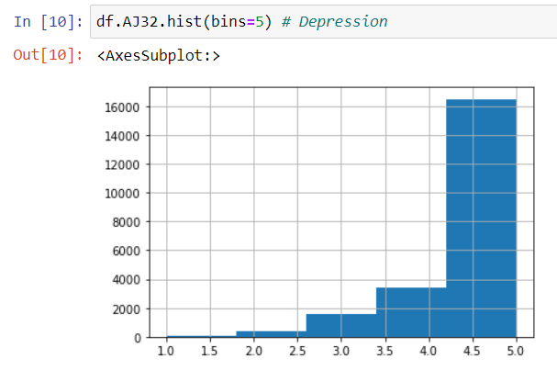
Prepare - visualization
Histogram of dependent variable DEPRESSION. Left Skew.
AJ32: Feeling depressed in the past 30 days?
Coding:
1 = all the time
2 = most of the time
3 = some of the time
4 = a little of the time
5 = not at all

Slide 19
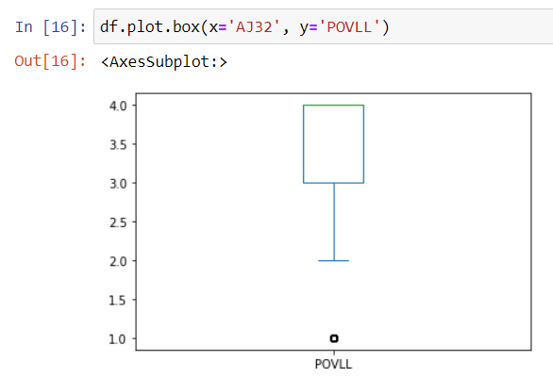
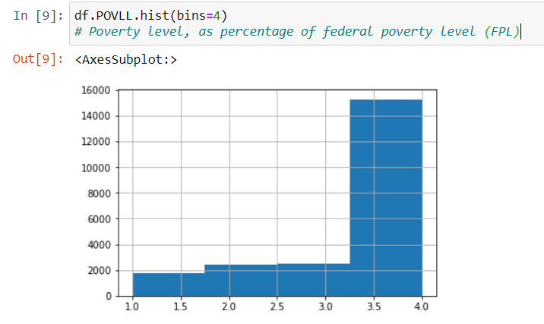
Prepare - visualization
Histogram of POVERTY and box plot of DEPRESSION vs POVERTY. Left Skew.
Federal Poverty level (FPL)
Coding
1 = 0-99% FPL
2 = 100 to 199% FPL
3 = 200 to 299% FPL
4 = 300% FPL and above

Slide 20
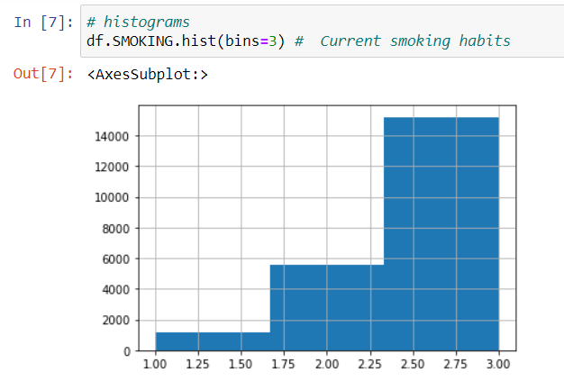
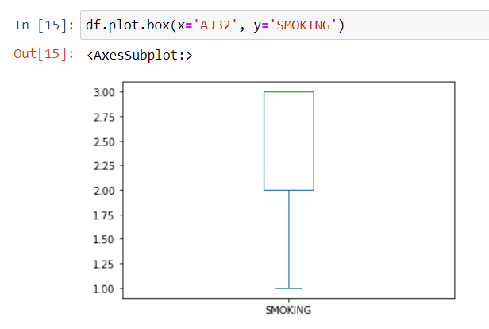
Prepare - visualization
Histogram of SMOKING and box plot of DEPRESSION vs SMOKING. Left Skew.
Current smoking habits
Coding
1 = currently smokes
2 = quite smoking
3 = never smoked regularly

Slide 21
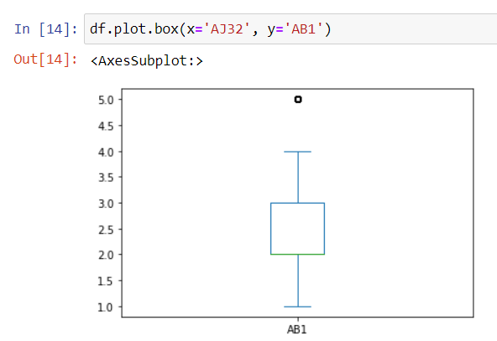
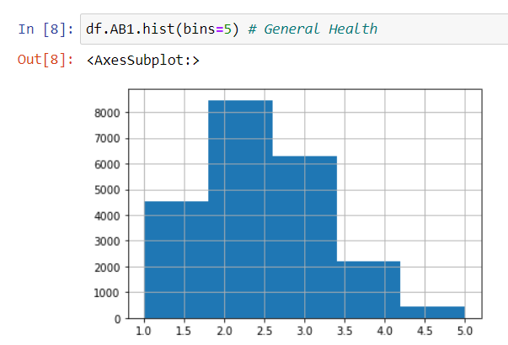
Prepare - visualization
Histogram of GENERAL HEALTH and box plot of DEPRESSION vs GENERAL HEALTH , either right skew or might be normal. Difficult to determine.
General Health Condition
Coding
1 = excellent
2 = very good
3 = good
4 = fair
5 = poor

